Slide 1

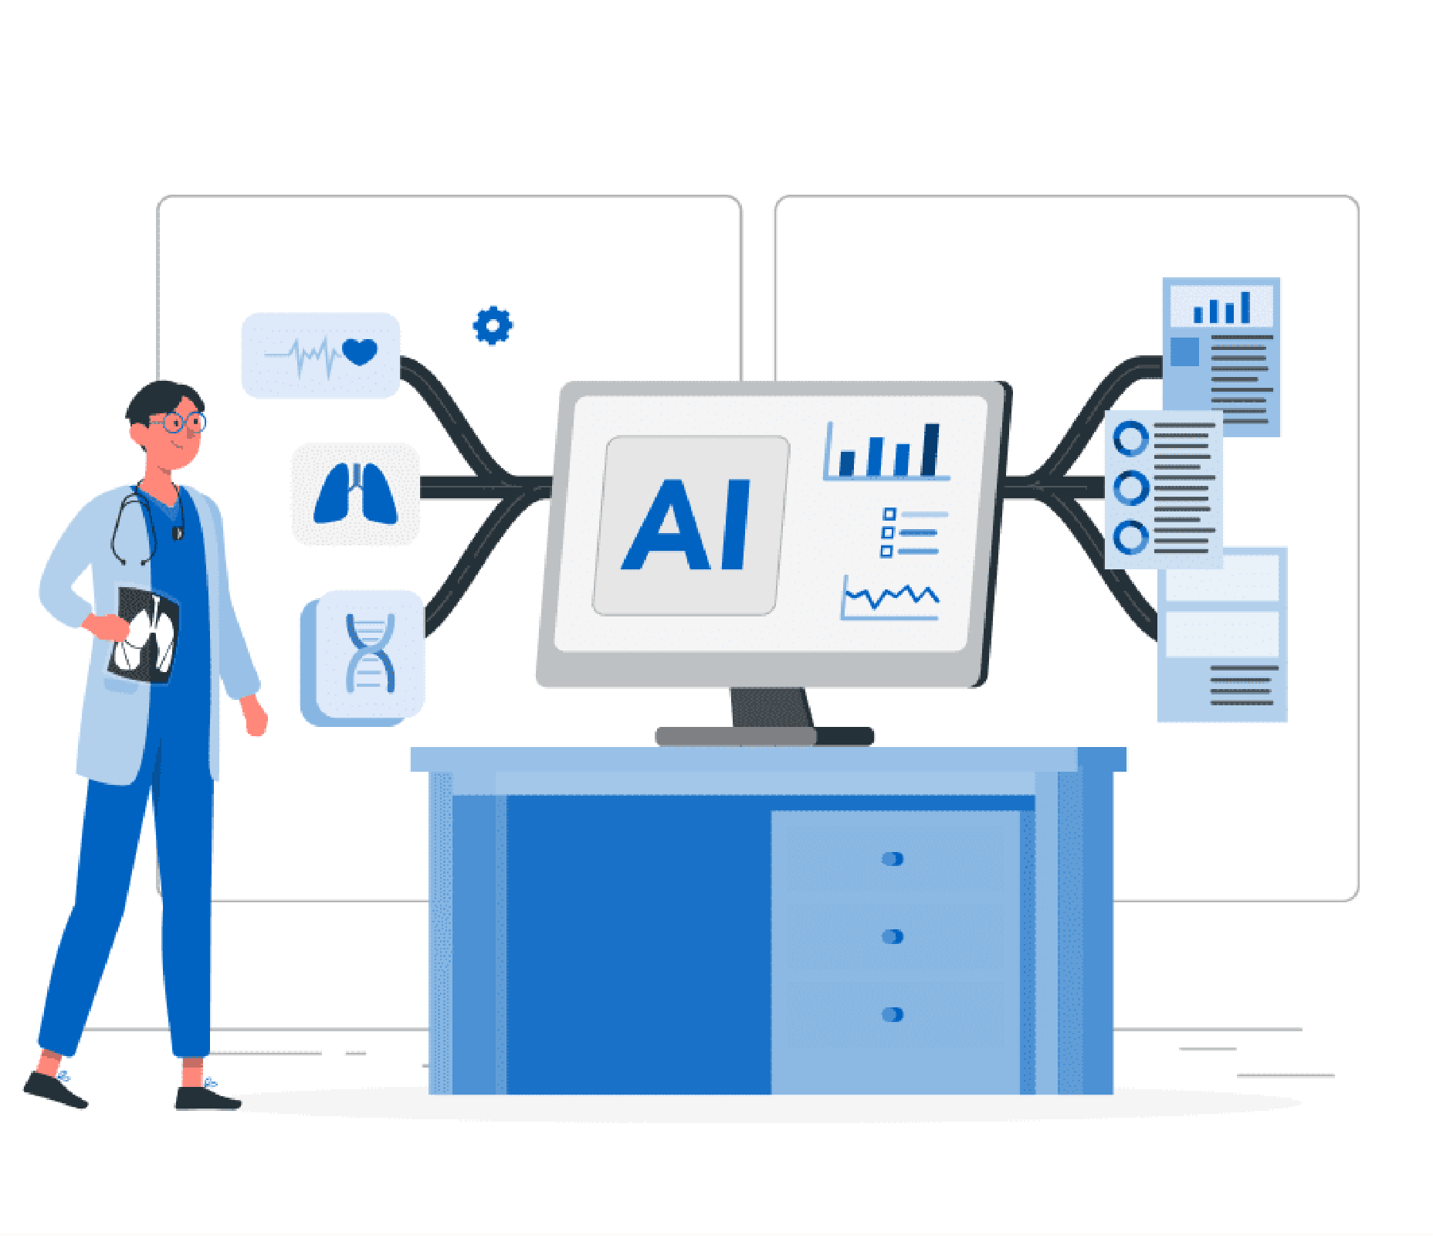
MedInsure
Sagar Mangal- E23CSEU2307
Aditya Karanwal- E23CSEU2290
Nimish Shukla – E23CSEU2286
Divyansh Srivastava-E23CSEU2288
Mentor- Dr. Rashmi Kumari

Slide 2
PROBLEMSTATEMENT
It is really very difficult to predict fair and accurate health insurance premiums due to the fact that there are no clear pricing methods. As a consequence, many do not understand how indeed their costs are calculated by the insurer, thus leading probably to a lot of frustration. Traditional modeling tends to use generalized actuarial tables, which probably don't allow reflection of all relevant individual risk factors. Without any kind of system transparency, the users do not have access to ways of estimating how things such as age, BMI, smoking habits, or location affect their premiums. Such lack of insight makes planning one's finances or comparing different policies difficult.

Slide 3
CHALLENGES
Data Quality & Preprocessing
Managed BMI outliers to prevent prediction bias
Encoded categorical features (smoker status, region) for ML compatibility
Model Development
Overcame Linear Regression's poor performance with non-linear data
Balanced accuracy and efficiency (avoided slow SVR without benefits
Interpretation & Fairness
Maintained model simplicity for user understanding
.
Implementation
Designed for real-world application with varied user inputs

Slide 4
SOLUTIONS
Data Preparation
Fixed outliers using IQR capping and winsorization for BMI
Encoded categories (smoker: 1/0, regions: one-hot) for ML readiness
Model Building
Chose XGBoost/Random Forests over Linear Regression for non-linear data
Tuned hyperparameters with GridSearchCV + cross-validation
Deployment
Identified key factors (smoking, BMI) via SHAP visualizations
Prevented bias by normalizing age/BMI ranges
.
Explainable & Fair AI
Exported as .pkl file for easy API integration
Added user-friendly features

Slide 5
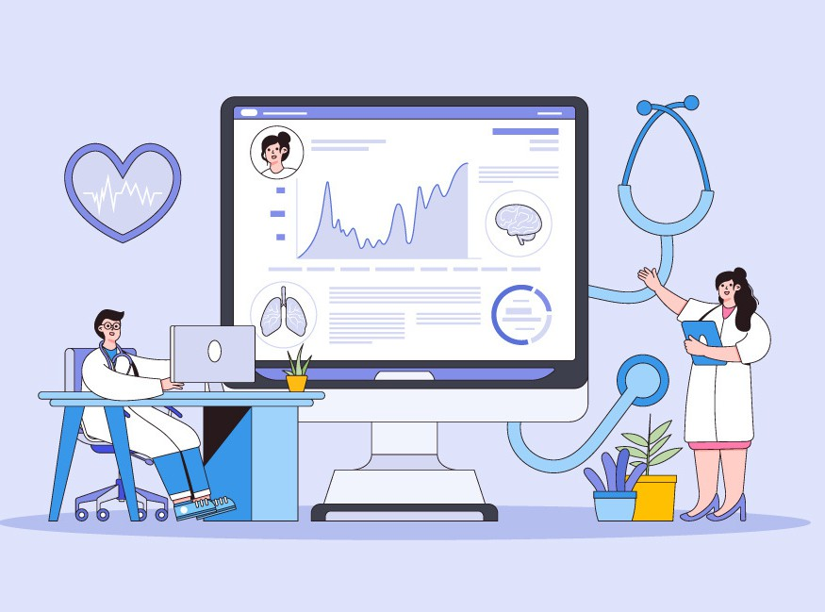
INNOVATION
Dynamic User Guidance System
Wellify AI makes short health history
summaries for quick insights.
Ethical AI Framework
Bias detection algorithms to flag potential unfair pricing across demographics
Preventive Health Integration
Lifestyle impact projections (e.g., showing 5-year cost differences for smoker vs non-smokers)

Slide 6
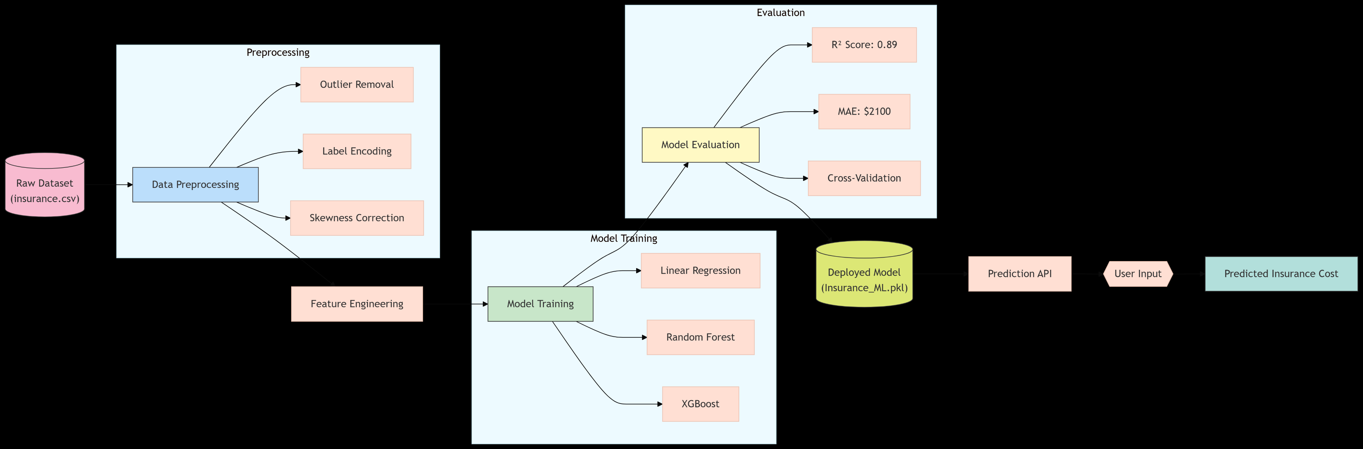
ARCHITECTURE DIAGRAM

Slide 7



TECHSTACK
FRONTEND
BACKEND
HTML/CSS
JAVACRIPT
PYTHON
NODE.JS

Slide 8
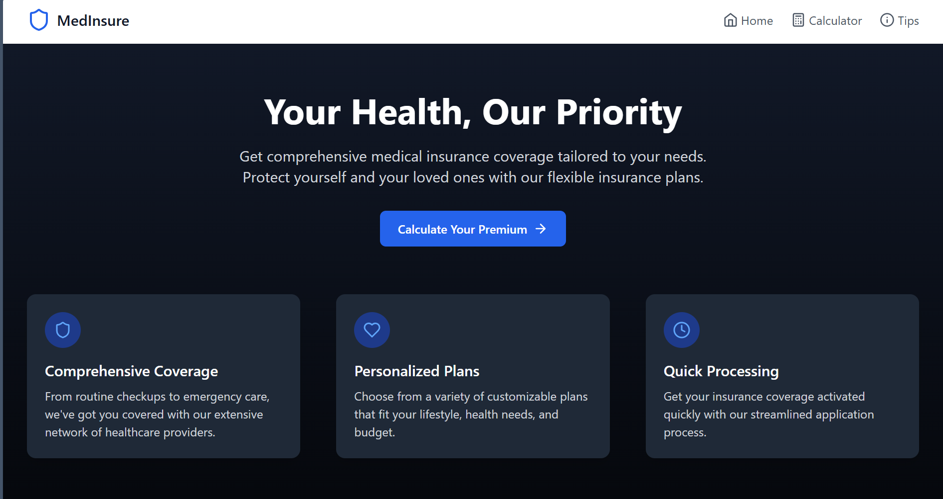
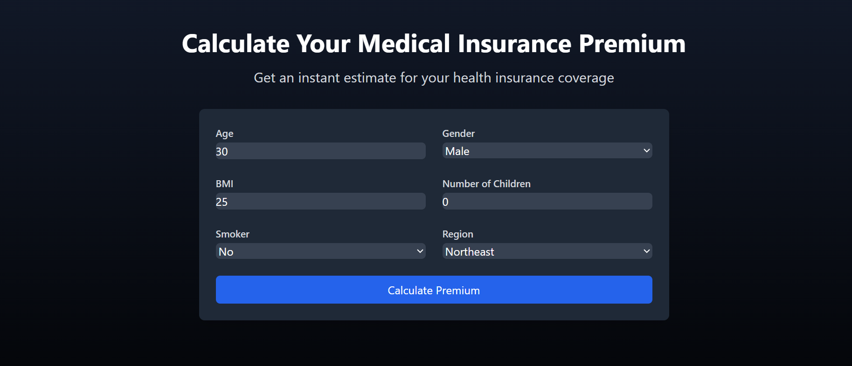
UI

Slide 9
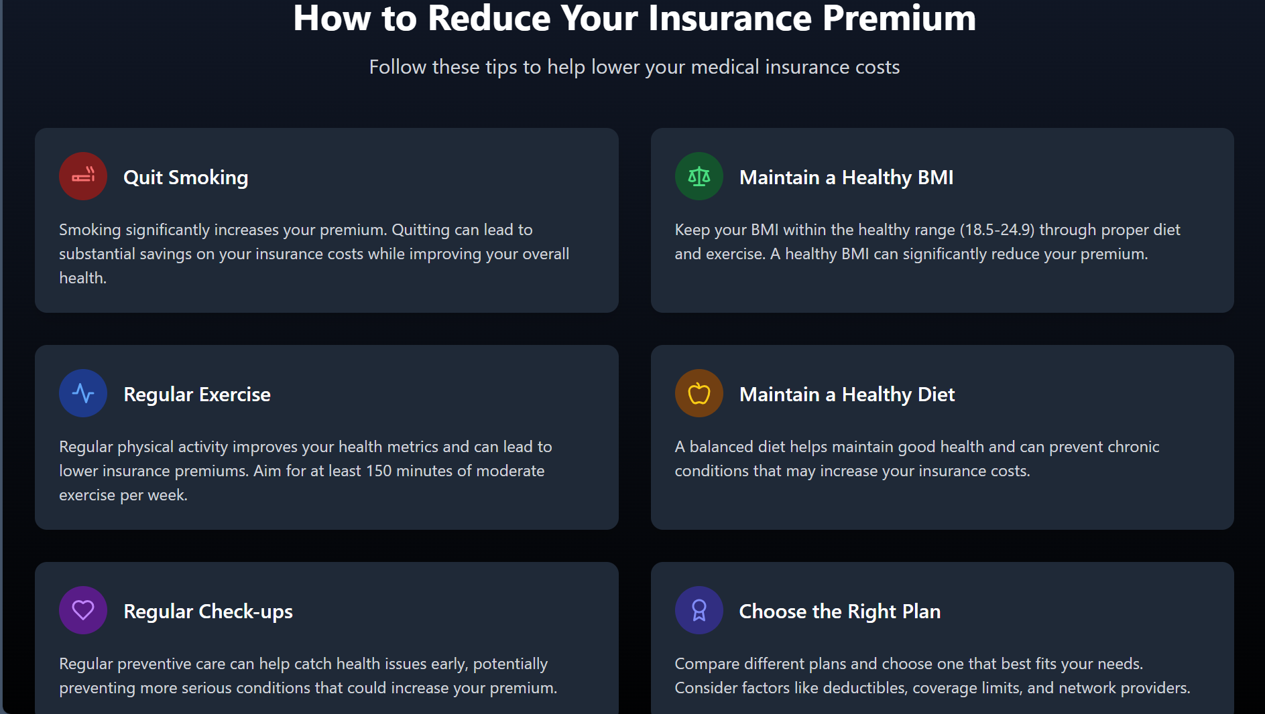
UI

Slide 10
Thankyou

